Slide 1

Team Name : Grand Glory
Problem Statement :Real-Time High Scale Financial Fraud Risk Management

Slide 2

Brief about the Idea
Real-time high scale financial fraud risk management using machine learning models that can identify suspicious transactions based on pre-defined rules by using Logistic Regression, XGBoost, SVM, KNN Regression. But using Deep learning algorithms over ML can automatically build classification rules from large datasets and detect new and evolving fraud patterns, making them a critical component of any fraud detection strategy for analyzing vast amounts of transactional and consumer data in real-time.

Slide 3
Opportunity :
A deep learning fraud detection system employs complex neural networks to scrutinize vast volumes of data, extracting intricate patterns that elude traditional methods. It promptly identifies anomalies and fraudulent activities by learning from historical cases, adapting to evolving tactics. This system enhances accuracy through continuous learning, minimizing false positives and negatives. In the real world, it rapidly processes transactions, ensuring secure operations for businesses and customers. Its adaptive nature ensures resilience against emerging threats, providing a robust defense against multifaceted fraudulent schemes across industries.

Slide 4
List of features offered by the solution :
A deep learning fraud detection system encompasses a range of valuable features for effective fraud prevention. This includes continuous data analysis, extracting crucial features through segmentation, and employing unsupervised learning to uncover patterns without labeled data. Anomaly detection capabilities identify unusual behaviors swiftly, aided by real-time monitoring and integration with rule-based systems. Natural language processing enhances text data analysis. The system scales seamlessly to handle extensive data volumes, delivering high accuracy and precision to minimize false results. Moreover, its adaptability ensures ongoing learning, bolstering performance against evolving fraud tactics. These combined capabilities fortify businesses against multifaceted fraudulent activities.

Slide 5
Proposed Solution
The proposed fraud prediction system utilizes deep learning techniques to analyze extensive transactional data. It constructs complex neural networks that learn from historical fraud instances, enabling real-time anomaly detection. Through continuous adaptation and refinement, the system effectively identifies and prevents fraudulent activities, ensuring secure and trustworthy business operations.

Slide 6
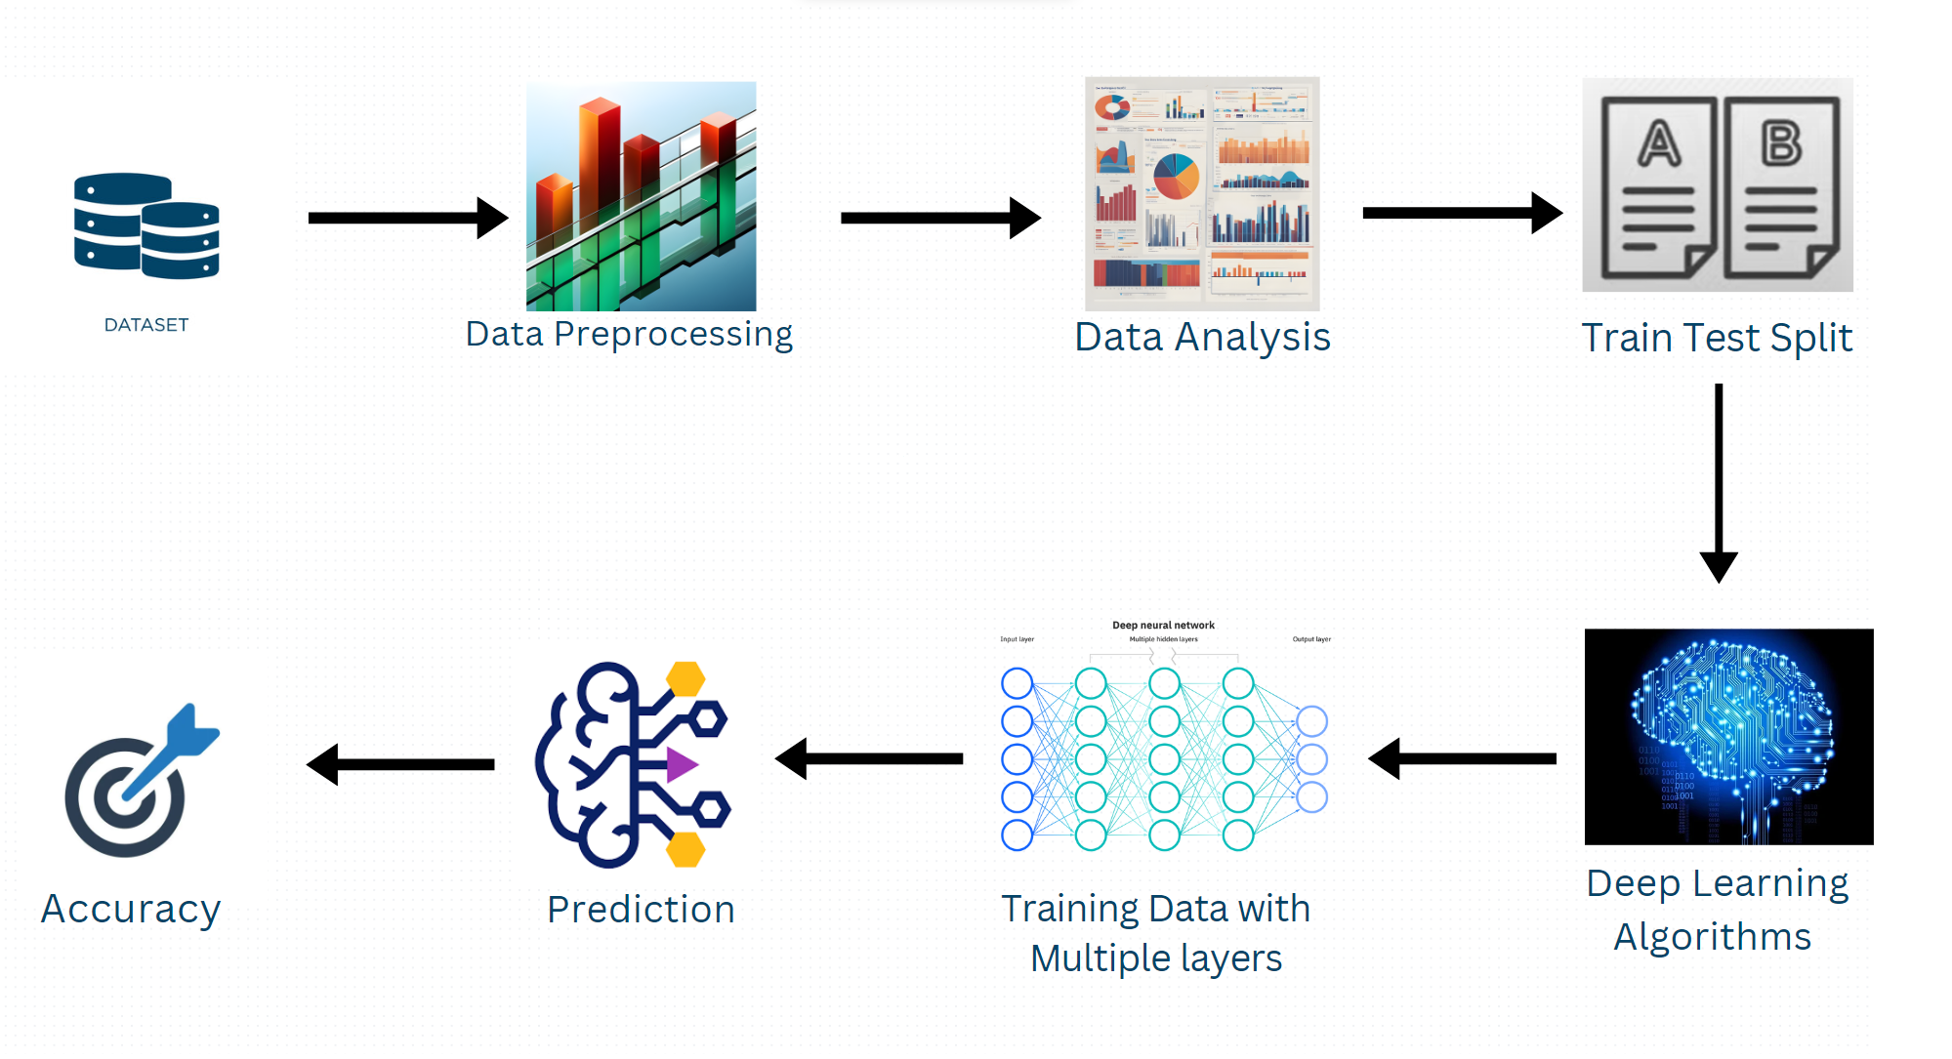

Process Flow Diagram/Usecase Diagram

Slide 7
Architecture
The fraud prediction system's architecture employs a multi-layered neural network model. Input data, including transactional attributes, flows through several hidden layers, extracting intricate patterns. These patterns are then used to identify anomalies and potential fraud cases. The model continuously refines itself using backpropagation and adapts to emerging threats, ensuring robust and accurate fraud detection.

Slide 8
Business Logic of the solution :
The proposed solution's business logic centers on leveraging deep learning to enhance fraud prediction. It involves collecting and preprocessing vast transactional data. This data is then fed into the neural network, which learns from historical fraud cases to identify anomalies. The system's adaptability enables it to refine its detection capabilities over time. Detected anomalies trigger alerts or interventions, minimizing false positives. The solution's real-time processing facilitates swift decision-making, maintaining secure business operations. Continuous model updates based on new data ensure resilience against evolving fraud tactics, safeguarding financial interests, customer trust, and operational integrity.

Slide 9

Technology used :

Slide 10
Estimated cost of/after implementing the solution :
The estimated cost of developing and implementing a real-time high-scale deep learning model for Financial Fraud Risk Management can vary significantly depending on factors such as the complexity of the model, the amount of data processing required, infrastructure costs, and the expertise of the team involved. Generally, such projects can range from several lakhs to a few crores of Indian rupees. For a more accurate estimate, it's recommended to consult with experts in the field or machine learning development companies who can provide a tailored cost analysis based on your specific requirements.

Slide 11
Demo Video/Live Demo
https://drive.google.com/file/d/1he7PyFzUuRBvyFMgKKjAI7SKTNvhgPta/view?usp=sharing

Slide 12
GitHub Link (Codes should be public and available after hackathon also)
https://github.com/B-Praveenkumar10/Pitch-to-SBI-Hackathon

Slide 13
Results Summary
The results of the deep learning model for fraud prediction in banking are promising. The model demonstrates a high accuracy in identifying fraudulent transactions, significantly reducing false positives and negatives. Its real-time processing capability enables timely intervention, preventing potential financial losses. The model's adaptive nature ensures it learns from new fraud patterns, maintaining its effectiveness against evolving tactics. Overall, the deep learning model enhances the bank's ability to detect and prevent fraud, safeguarding customer assets and bolstering operational trust. Ongoing refinement and updates to the model continue to improve its performance and resilience against emerging threats.

Slide 14


